Slide 1
WIGOS Metadata Representation … Revisited
Jörg Klausen
Chair TT-WIGOSMD, Co-chair ET-Metadata, Chair ET-ACDM
joerg.klausen@meteoswiss.ch
Members of WMO TT-WIGOSMD, TT-CDM, TT-WISMD, ET-ACDM
Kathi Schleidt (DataCove), OGC OMS SWG

Slide 2
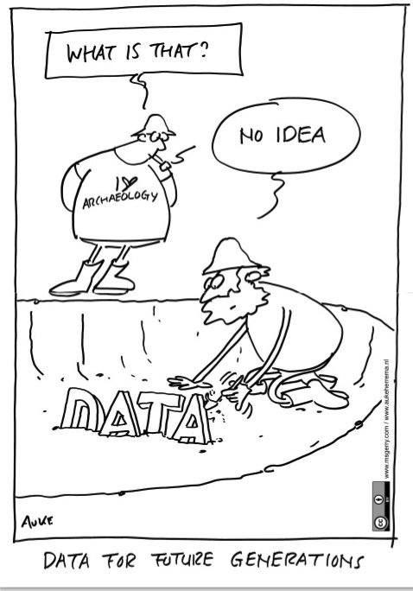

Slide 3
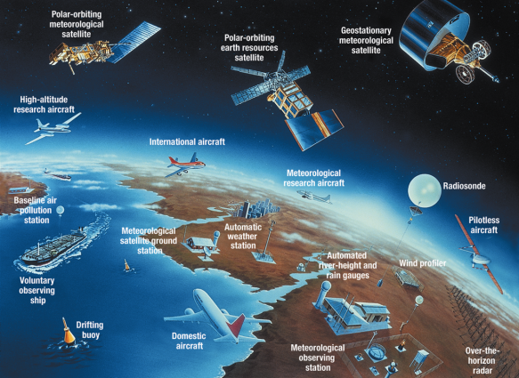
Motivation
Meteorology, climatology, environmental science need many, globally distributed observations
Feed numerical weather models
Determine climate trends
Support public health
Support industry and transport
Verify environmental policy measures
Support science
Measurements obtained for different purposes, with different quality requirements and different representativeness
→ ‘Adequate use of observational data’ requires comprehensive metadata

Slide 4
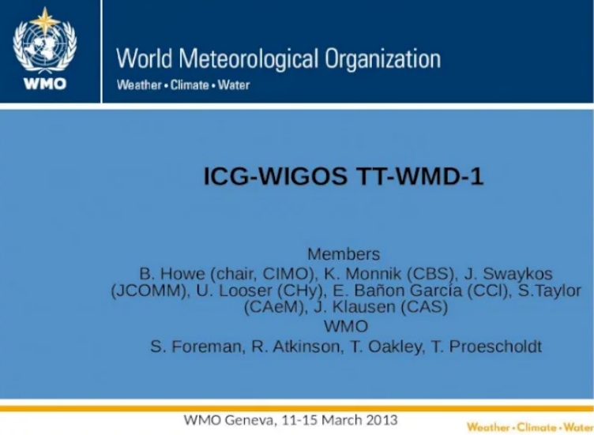
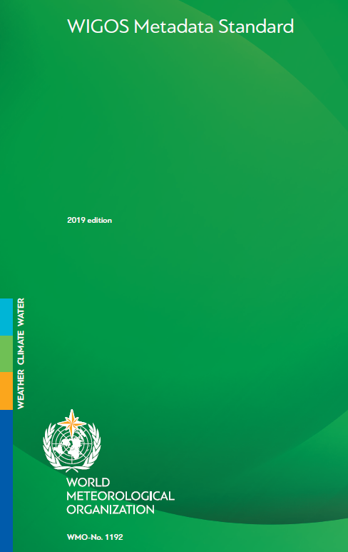
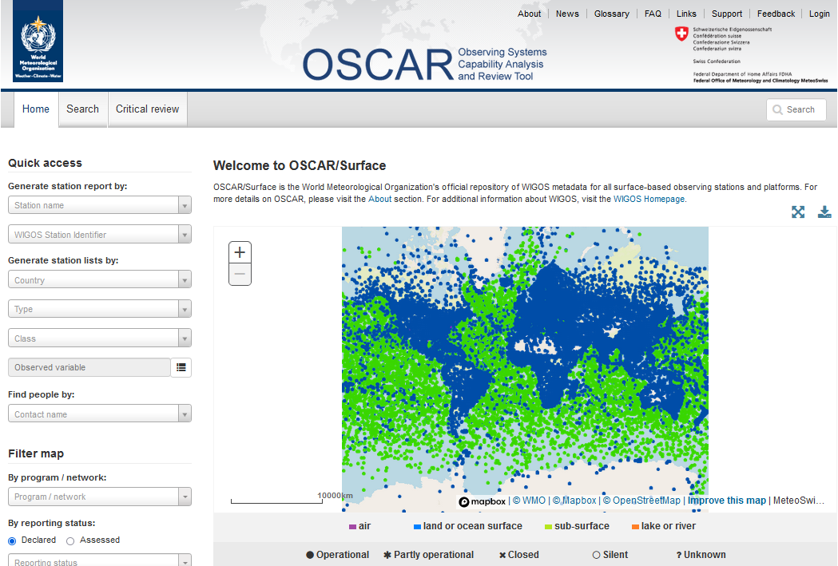
Background
WIGOS metadata model 1.0 developed based on experience from various communities under the WMO umbrella 2013/2014
Published and endorsed at WMO Cg-17 (WMDS 2015, update 2019)
Formally specified as a GML XSD, based on ISO19156:2011 / OGC O&M (WMDR1.0)
(Most comprehensively) implemented in OSCAR/Surface, supported by an API for exchange of XML files
WMDS (2015) https://library.wmo.int/?lvl=notice_display&id=18648 (2015)
WMDS (2019) https://library.wmo.int/index.php?lvl=notice_display&id=19925 (2019)
WMDR1.0 https://github.com/wmo-im/wmdr
OSCAR/Surface https://oscar.wmo.int/surface

Slide 5

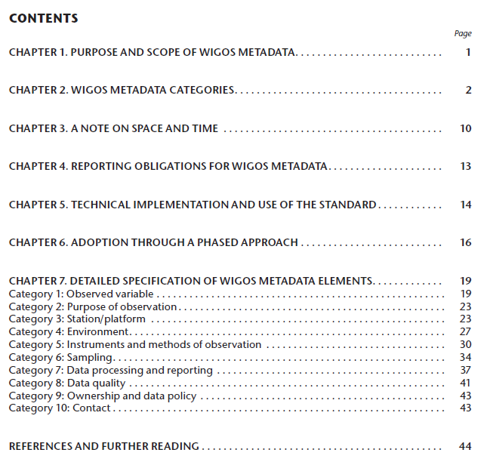
WIGOS Metadata Standard
Atmosphere, land, ocean, space
Fixed, mobile observing facilities
In-situ, remote-sensing instruments
Physical, chemical, biological, hydrological observations
Weather, climate, hydrology, atmosphere, warnings, …
Descriptive Standard
XML Schema defining exchange format (WMDR 1.0)
WMO Reference Implementation
Observed variable
Purpose of observation
Station/ platform
Environment
Instruments & methods of observation
Sampling
Data processing and reporting
Data Quality
Ownership and Data Policy
Contact
https://library.wmo.int/index.php?lvl=notice_display&id=19925
https://oscar.wmo.int/surface

Slide 6


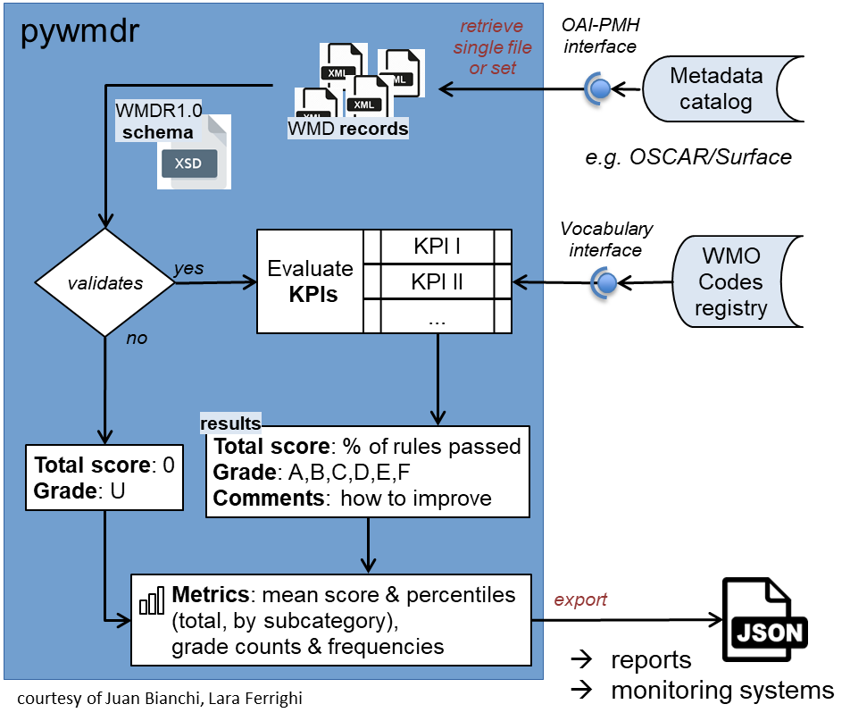

KPIs for WMDR XML quality assessment
pywmdr
OAI-PMH
interface
retrieve
single file
or set
Key Performance Indicators (KPI) developed by TT-WIGOSMD
https://github.com/wmo-im/wmdr/tree/issue42
set of rules grouped in 6 categories and 11 subcategories
1 - Schema compliance
2 - Station characteristics
3 - Observation/measurements – deployment
4 – Station contacts
5 – Bibliographic references and documents
6 – Value of a station for WIGOS
Pywmdr
https://github.com/wmo-im/pywmdr
Python application developed by TT-WIGOSMD
based on similar tool by TT-WISMD (pywcmp)
Features:
Validation against WMDR 1.0 schema (XML)
Validation of controlled vocabulary terms against https://codes.wmo.int/wmdr
KPI evaluation of single metadata documents or entire collections
assign grade to document according to the overall score
calculate metrics for collections and present as .json
bulk harvest of wmdr documents from a collection’s OAI web service
schedule harvest, recalculate metrics to monitor evolution over time
simple command line interface (CLI)
Metadata
catalog
WMDR1.0
schema
WMD records
e.g. OSCAR/Surface
validates
Evaluate
KPIs
KPI I
Vocabulary interface
WMO
Codes
registry
yes
KPI II
...
no
results
Total score: 0
Grade: U
Total score: % of rules passed
Grade: A,B,C,D,E,F
Comments: how to improve
Metrics: mean score & percentiles (total, by subcategory), grade counts & frequencies
export
reports
monitoring systems
courtesy of Juan Bianchi, Lara Ferrighi

Slide 7
Not even a standard can stand still …
Why change?
Basis for WIGOS metadata exchange format changes
ISO 19156:2011 / OGC O&M will be canceled
replaced by ISO 19156:2022 / OMS
Experience with current model shows some deficiencies
Submodel for observedProperty (“what’s observed”) has evolved significantly
Deployment/instrument/data generation model is a bit awkward …
General tendency to migrate from XML formats to JSON formats
Why change now?
OSCAR/Surface undergoing life-cycle
Climate data model and OpenCDMS being implemented now
→ Both need a stable information model

Slide 8
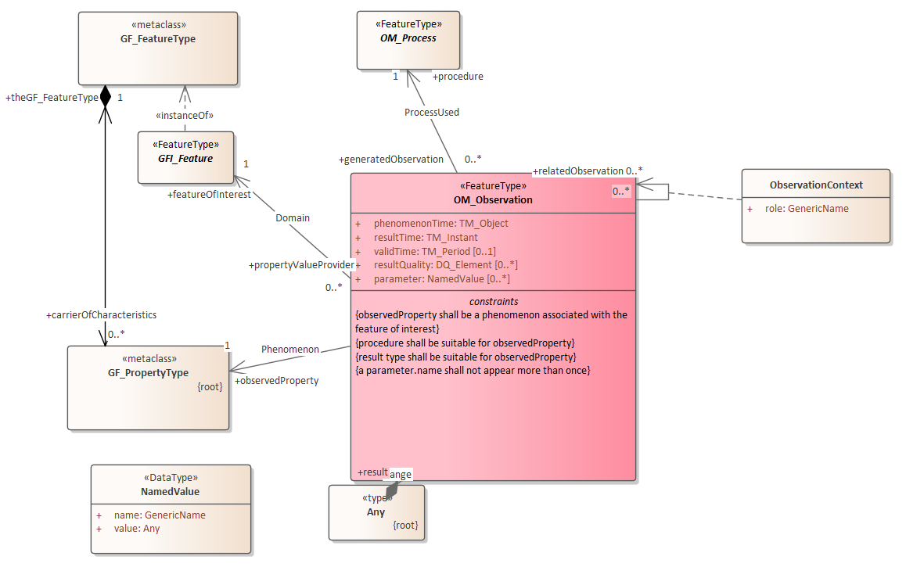
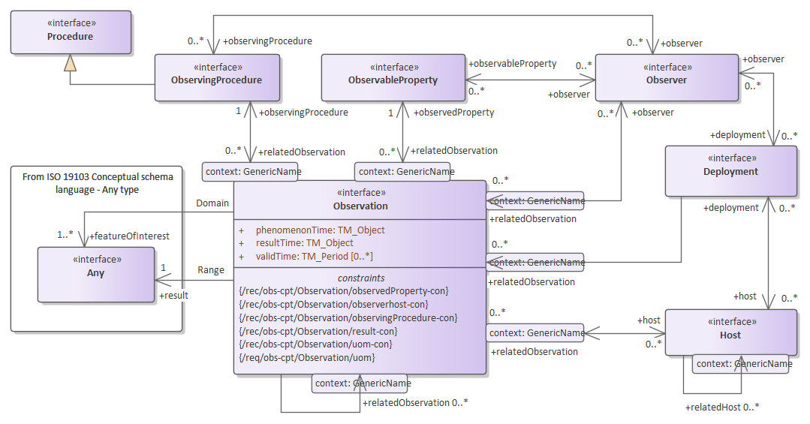
O&M becomes OMS
ISO 19156:2011 (OGC O&M)
ISO 19156:2022 (OGC OMS)
OM_Observation
Observation
OM_Process
ObservingProcedure
featureOfInterest
featureOfInterest
observedProperty
observedProperty
result
result
Host
Observer
Deployment
NEW

Slide 9
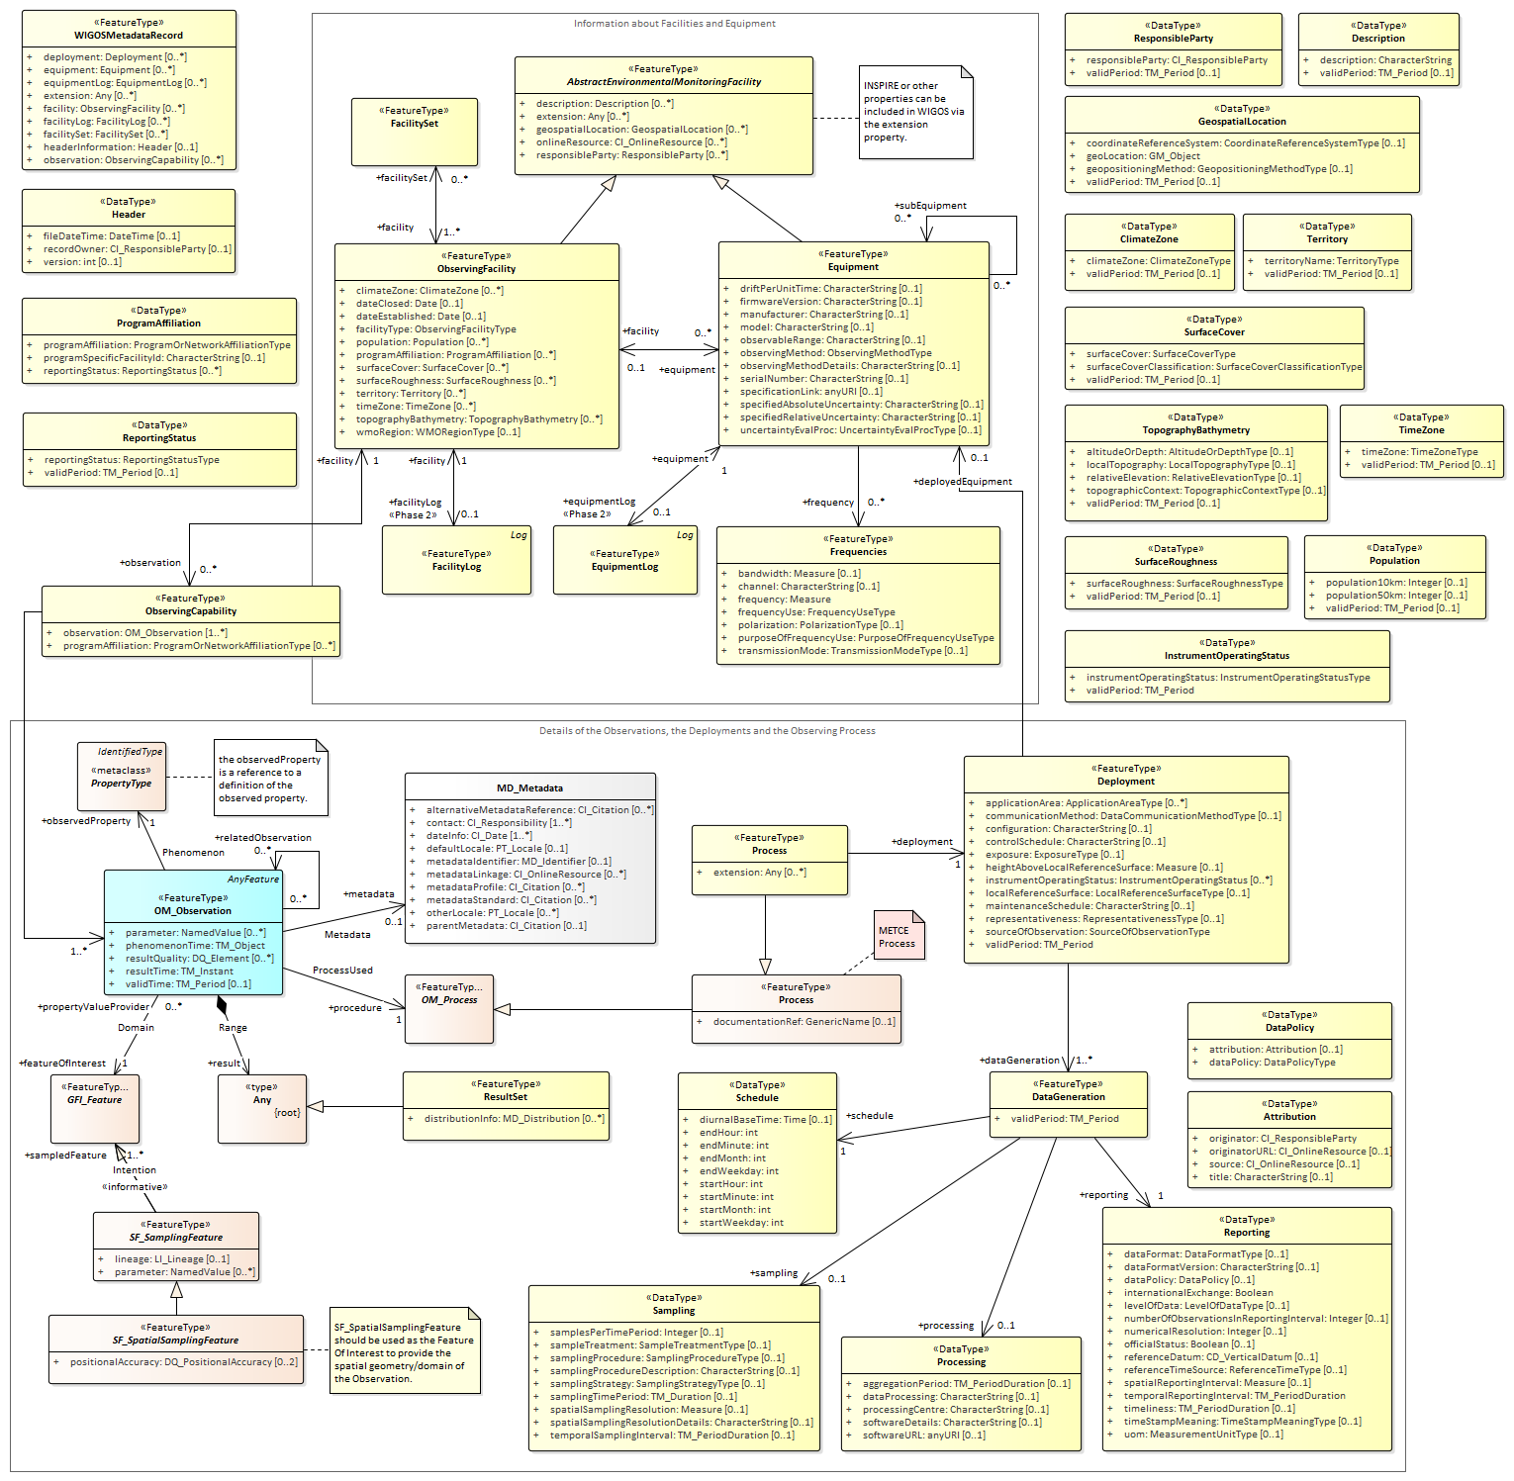
New concepts in OMS already exist in WMDR!
ISO 19156:2022 (OGC OMS)
WMDR 1.0
ObservingFacility
Equip-ment
Deployment
Host <- ObservingFacility
Observer <- Equipment
Deployment <- Deployment

Slide 10
What’s new in WMDR 2.0
ObservationCollection to describe time series based on OMS
Cleaner model to define ObservedProperty based on I-ADOPT framework
Simpler description of temporalCoverage (previously: schedule)
Cleaner model to describe ObservingProcedure, processing and reporting based on OMS
→ Much the same concepts, but more logical organization of information

Slide 11

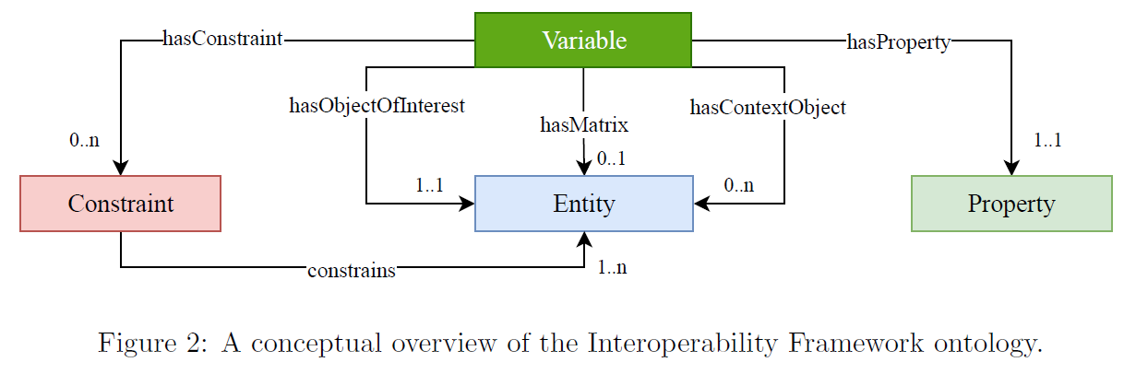
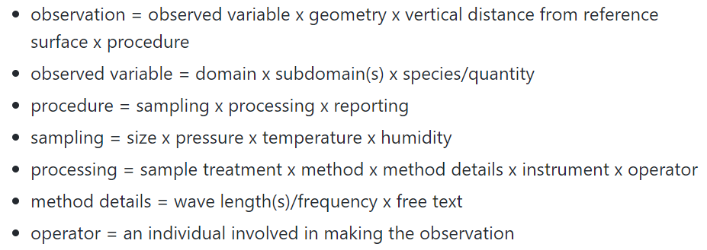
What’s RDA I-ADOPT?
Ontology framework to describe observations of state variables and properties of observable quantities by decomposing variable names
https://i-adopt.github.io/index.html
WIGOS Metadata WMDR 1.0 | I-ADOPT
codes.wmo.int/wmdr/ObservedVariable | ObjectOfInterest
codes.wmo.int/wmdr/Matrix in approval process | Matrix
various related concepts, e.g., sampling, processing, wavelength/frequency, vertical distance from reference surface | Constraint
domain, subdomain | ContextObject

Slide 12

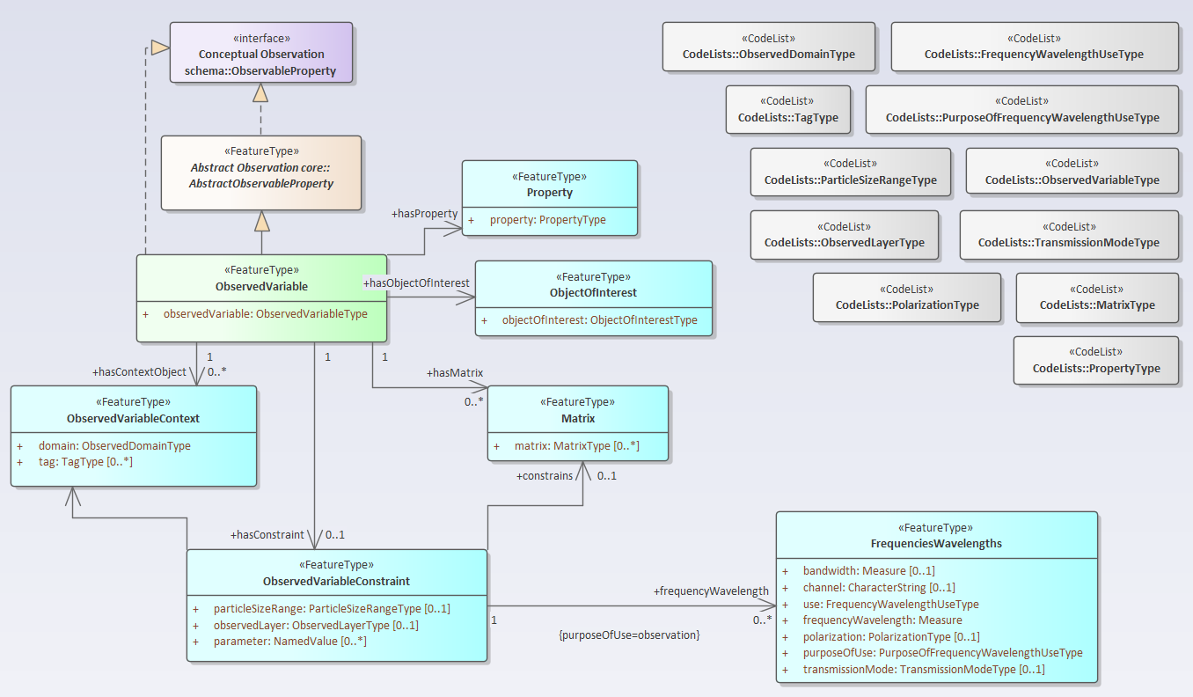
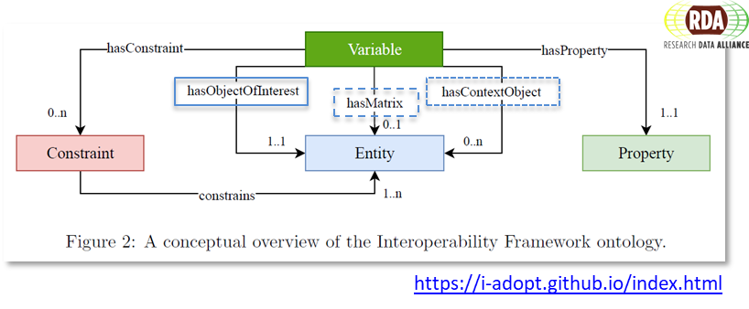
ObservedVariable in WMDR2.0
https://i-adopt.github.io/index.html
→ Vocabularies (code lists) governed by WMO TT-WIGOSMD

Slide 13
Examples for WMDR2.0 ObservedVariable
ObservedVariable composed from
ObjectOfInterest
Matrix
ContextObject
Temperature of the air of the atmosphere at 2 m above natural ground
Chlorophyll content of the surface layer of the ocean
Scattering coefficient of the PM10 fraction of aerosol particles in the air of the atmosphere at 20°C and 40% relative humidity at 3 m above natural ground
Matrix or Constraint?
Constraint or SampleConditioning?
WIGOS Metadata WMDR 1.0 | I-ADOPT
codes.wmo.int/wmdr/ObservedVariable | ObjectOfInterest
codes.wmo.int/wmdr/Matrix in approval process | Matrix
various related concepts, e.g., sampling, processing, wavelength/frequency, vertical distance from reference surface | Constraint
domain, subdomain | ContextObject

Slide 14
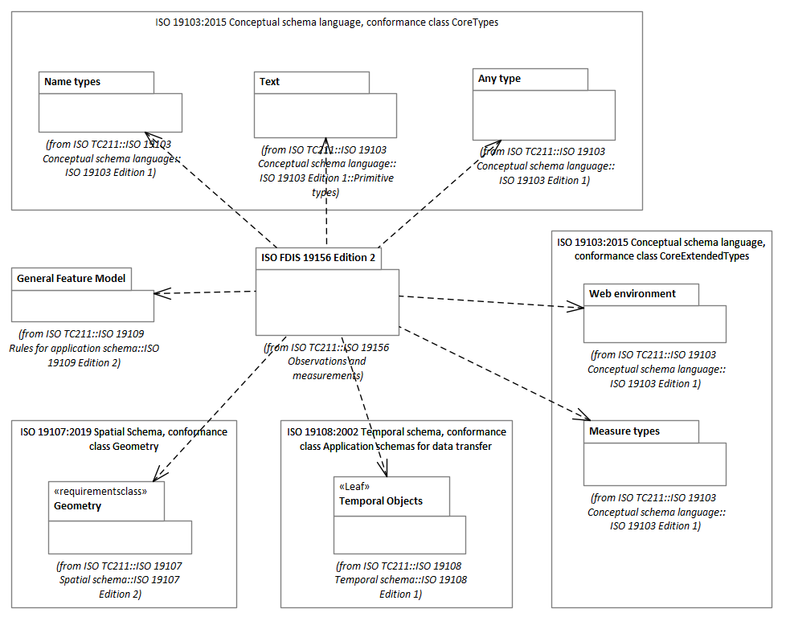
OMS remains embedded in ISO 19xxx
Source: http://iso.sparxcloud.com/index.php

Slide 15
Summary & Conclusions
Globally distributed environmental observations need a lot of metadata to enable ‘adequate use’
WIGOS Metadata Representation (WMDR) supports this requirements for many application areas including climate data
O&M was a useful foundation for WMDR1.0, OMS is better!
OMS includes all aspects needed → promising candidate for the evolution of WMDR
Transition from O&M-based WMDR 1.0 to OMS-based WMDR 2.0 carries a cost, needs a community effort and WMO-Cg approval
Latest WMDR2.0 model draft viewable at https://wmo-im.github.io/wmdr2/html/
Next steps
Test I-ADOPT framework for generation of ObservedVariable names
Refine WMDR2.0 full model and start testing model logic
Develop serialization in XML, JSON
Develop formal specification document

Slide 16
Acknowledgements
WIGOS Metadata Standard
WMO TT-WIGOSMD
ET-ACDM members
Initial UML model
Dominic Lowe (formerly BoM)
Jeremy Tandy (UKMO)
Tom Kralidis (EC)
Evolution of UML model
Kathi Schleidt (DataCove)
Barbara Magagna (I-ADOPT)
OGC OMS SWG
Users
<wmdr:extension>
<wmdr:acknowledgement>
<gco:CharacterString>
Thank you for your attention
</gco:CharacterString>
</wmdr:acknowledgement>
</wmdr:extension>

Slide 17
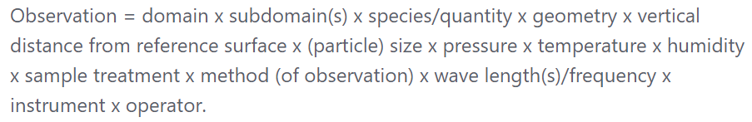
WMDR Observation
https://github.com/wmo-im/wmds/wiki/The-idea-and-concept-behind-WMDS

Slide 18
OMS vs WMDR Initial Cross-Walk
WIGOS Metadata WMDR 1.0 | OGC/OMS ISO19156:2022
ObservingFacility | Host
ObservingCapability | Observation
ObservableProperty | ObservableProperty
Process/Procedure | ObservingProcedure
Deployment | Deployment
Equipment | Observer
FacilitySet | n/a
ProgramNetwork | n/a
gml | Conceptual schema language → any

Slide 19
I-ADOPT
https://doi.org/10.15497/RDA00071
https://i-adopt.github.io/index.html

Slide 20
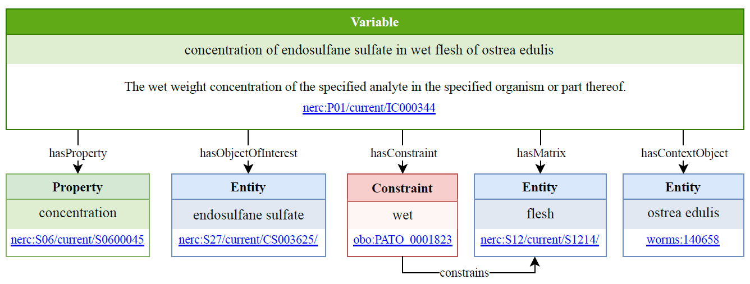
I-ADOPT Example

Slide 21
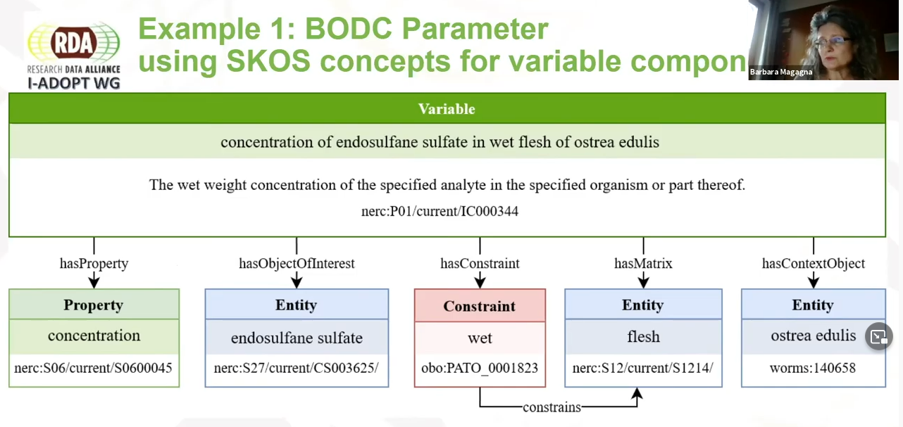
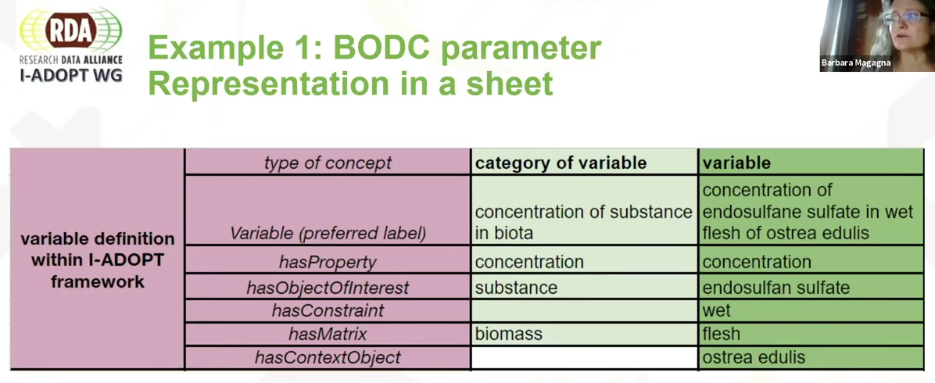

Slide 22
